Slide 1
終極密碼
106 數位系統導論實驗 專題 16組
組員：孫名柔/段雅培/林亭伃/曾韻如/曾大瑋/伍志忠

Slide 2
Introduction 1

Slide 3
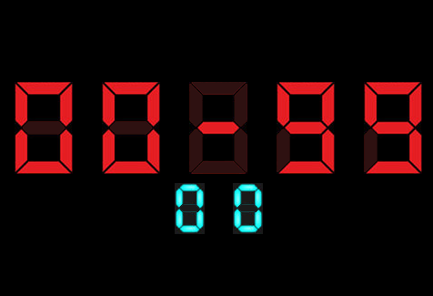
Information
題目：終極密碼

Slide 4
flow
Step 0：按下reset鈕，重置遊戲
Step 1： 使用switch決定要猜的數字
用SW0 - SW6輸入二進位數字
Step 2：使用SW0確認，要猜的數字
Step 3：若猜錯回到Step1，猜對則回到Step0

Slide 5
Basic Function

Slide 6
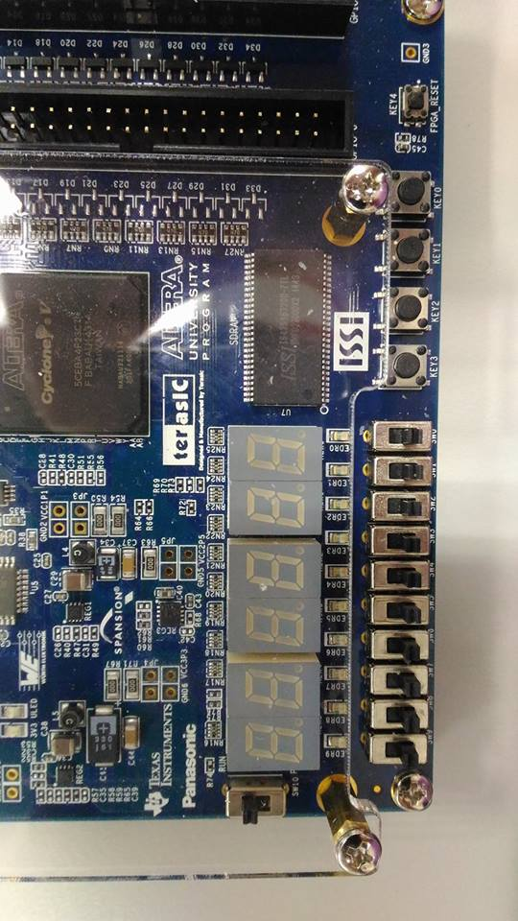
Reset
任何狀態下都能將遊戲重來

Slide 7
Seven Segment
開始時顯示範圍0-99，可猜測數字範圍01-98
顯示方式如下圖
Lower Bound
Guess Number
Upper Bound

Slide 8
Switch
撥SWITCH確認輸入二進位數字

Slide 9
Key buttons
按KEY0確認輸入的數字

Slide 10

Dot Matrix
猜對數字後，顯示通關訊息

Slide 11
Introduction 2

Slide 12
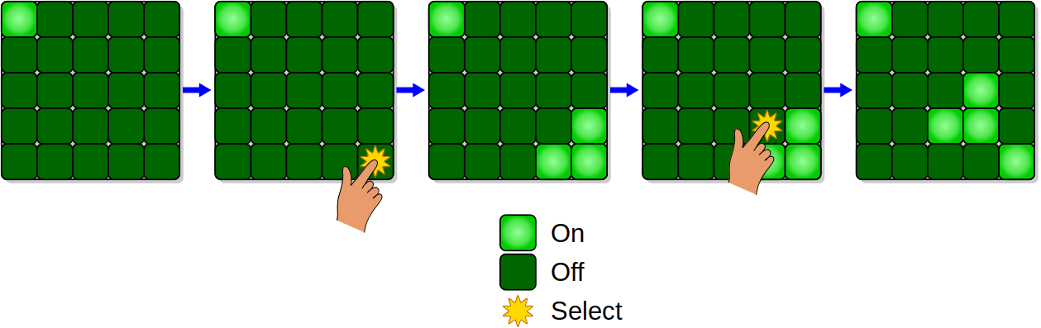
Information
題目：light out

Slide 13
flow
Step 1： Use button to move x,y to selection
Step 2：Use button to turn on/off the lights
Step 3：If all the light are turn on then game end,
else repeat step 1,2

Slide 14
Basic Function

Slide 15
Seven Segment
開始時顯示範圍0, when pressed check button the number of tries +1
顯示方式如下圖
Number of tries

Slide 16
Monitor
The light will show on monitor as a 4*4 matrix
Turn on all the light means game end

Slide 17
Key buttons
Press key 2,3 to move x,y
按KEY0確認輸入的數字

Slide 18
LED LIGHT
When all lights are turn on, led light will show up to notify you finish

Slide 19
Introduction 3

Slide 20
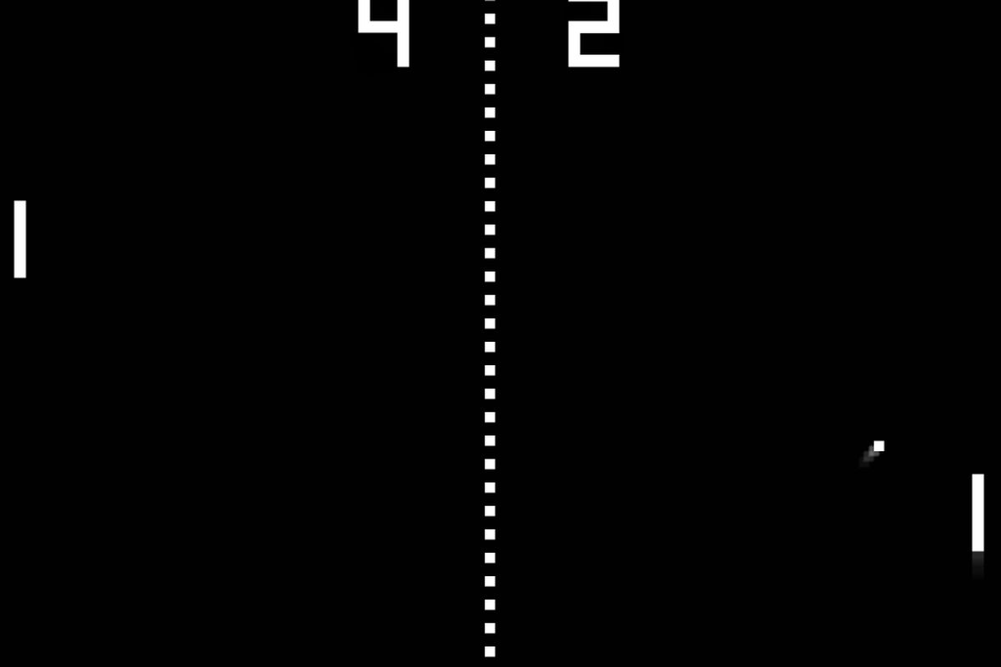
Information
題目：ping pong

Slide 21
flow
Step 1： Use button to p1,p2 board(this game is 2 players!)
Setp2: If ball fall out of the range then player get point
Repeat 1 and 2 till one of the player got 3 points

Slide 22
Basic Function

Slide 23
Seven Segment
開始時顯示0-0, when player got point,point _+1
顯示方式如下圖
P1 point
P2 point

Slide 24
Monitor
Monitor will show 2 board and 1 ball on screen
Players need to use board to bounce ball back to defend

Slide 25
Key buttons
Press key 0,1 to move p1
Press key 2,3 to move p2

Slide 26
switch
Can use switch to change game’s difficulty,
When switch are on, the board will shrink as time passes

Slide 27
謝謝觀賞ヽ(●´∀`●)ﾉ

